Slide 1
CIS 125H: XHTML
Introduction

Slide 2
About Me
Software developer for over ten years
Software development business: Creative CyberSolutions
Second term teaching at LCC
Created a few personal web sites and a few professional web sites
Household
Wife
Daughter
Ten chickens
50,000+ bees

Slide 3
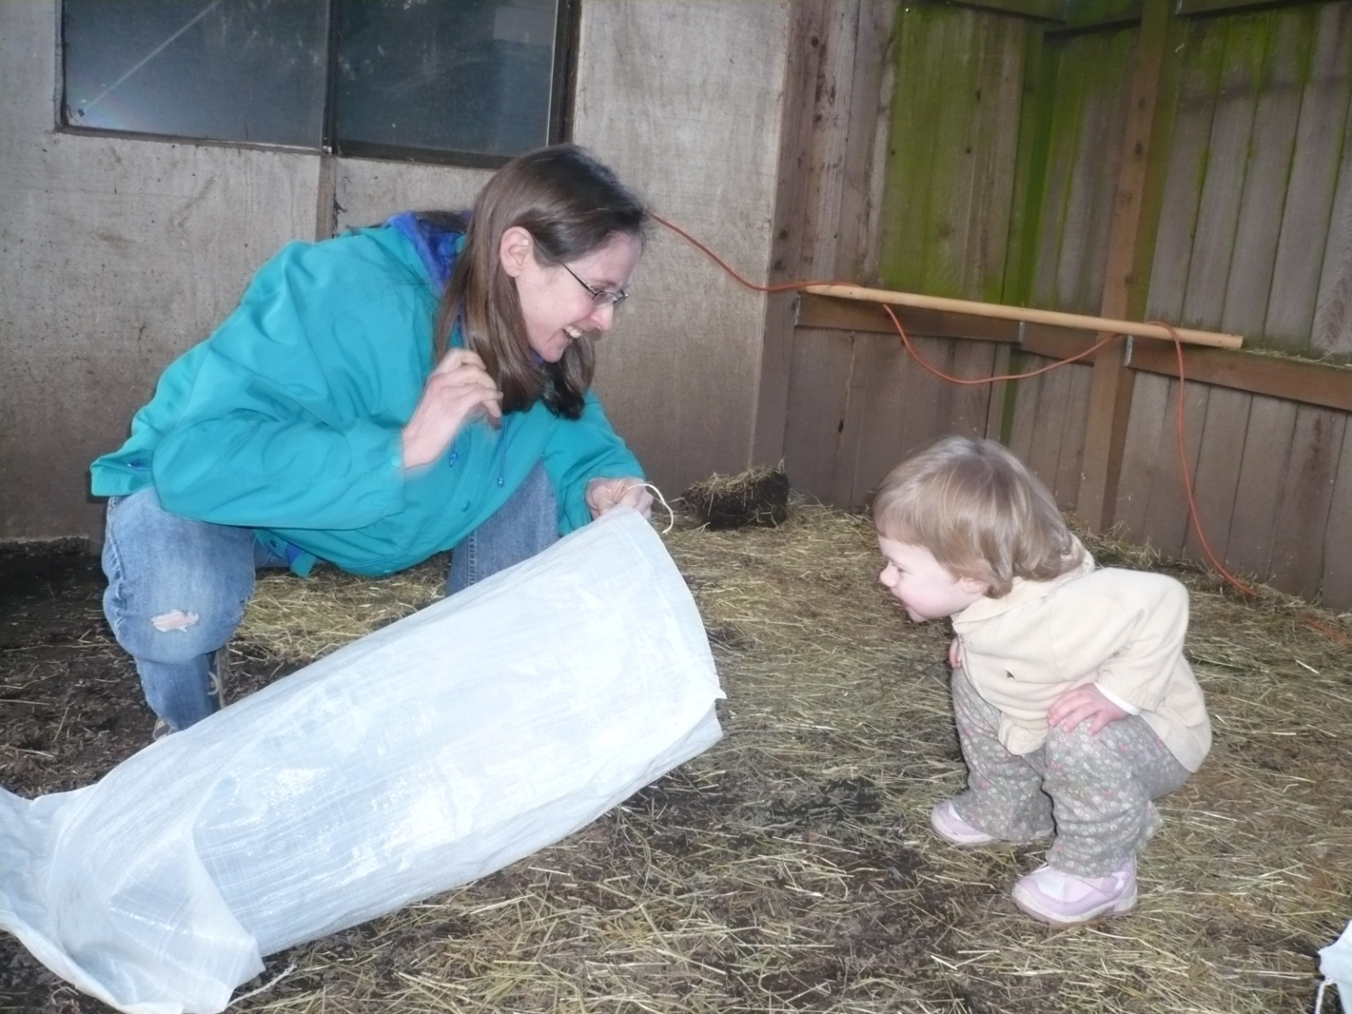
Amanda and Brianna

Slide 4

Brianna

Slide 5
About You
How many CIS majors?
How many have created a web site?
What technology did you use?
What do you want to be able to do after you finish this class?

Slide 6
Course Content
Basic web pages
Text formatting
Page layout
XHTML and CSS
Multimedia
Pictures
Video
Audio
Web site design
Organization of a web site
Layout of a web page
Interactivity
Forms
JavaScript
Java
DHTML
E-Commerce
Security
Online payments
Online stores
Web Promotion
Search optimization
Promotion

Slide 7
Course Methodology
Syllabus
moodle
Textbook
Quizzes
Labs
Core FTP

